Slide 1


Vega Map Development & GED Manager Upgrade
TD Securities · GED
Annie Zhang

Slide 2
Overview

Slide 3
Vega Map Generator
Risk visualization tool for structured notes
Breaks down Vega by strike & maturity
Generates separate heatmaps per underlying
Reveals hidden risk concentrations often missed by aggregated Vega
Pinpoints hotspots → prioritize & hedge precisely

Slide 4
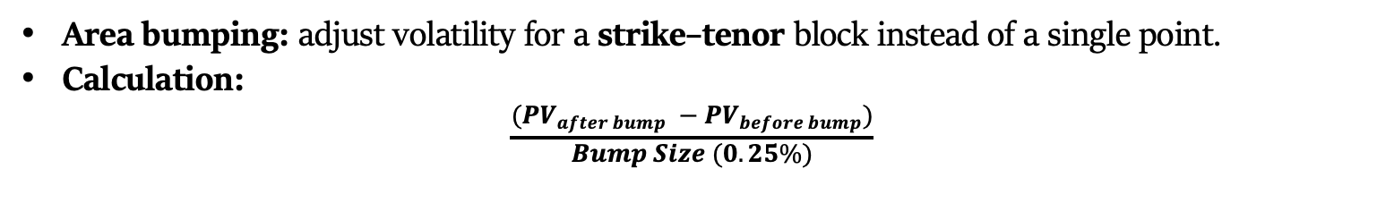
Vega Map
Area bumping: adjust volatility for a strike–tenor block instead of a single point.
Calculation:
$$\frac{(PV_{after bump} −PV_{before bump})}{Bump Size (0.25\%)}$$

Slide 5
Vega Map Generator
Step 1: Set parameters for the note
Step 2: Generate JSON (standardized termsheet)
Step 3: Generate Vega Map (one per underlying)
We’ll walk through the interface, set up an example, and view the output in real time.

Slide 6
From Risk Visualization to Actionable Hedges
Locate Vega hotspots across strikes and tenors.
01
Prioritize hedging where exposure is largest.
02
Track how Vega distribution shifts with market moves.
03
Plan targeted hedges instead of broad, costly trades.
04
Support scenario analysis for new issuance or market shocks.
05

Slide 7
GED Manager Upgrade – Overview
UI Update – New layout and added dropdowns and buttons for visual clarity and user interaction
Bug Fixed & Optimization – Resolved time data and occasional unavailability during specific periods & calculation optimization
Date Handling Correction
Exception Handling
Caching Optimization
Summary Table – Added IV, DIV, and Repo TD vs Totem benchmark comparison tables for quick and consistent performance checks

Slide 8
Summary Table Overview
Multi-Benchmark Coverage – Includes IV, DIV, and Repo benchmarks for a complete market view
Flexible Filtering – Supports tenor, strike, and tenor range selection with multiple calculation modes (min, max, mean, median)
Deviation Ranking – Automatically calculates TD–Totem differences and sort by the largest gaps
Automated Alerts – Sends daily email ensuring timely action

Slide 9
IV Summary Table
Select tenor & strike to lock in a specific implied volatility point.
Nearest neighbors: find the N maturities closest to the selected maturity (counting forward from today).
Calculate TD–Totem difference at the selected point for each ticker.

Slide 10
DIV Summary Table
Select tenor range to focus on a set of maturities.
For each maturity in the range, calculate the TD–Totem dividend yield (Annualized) difference.
This produces a list of differences for each ticker.
Apply one of four calculation modes (min, max, mean, median) to summarize that list into a single number for ranking.

Slide 11
Repo Summary Table
Select tenor range to focus on a set of maturities.
For each maturity in the range, calculate the TD–Totem forward rate (Annualized) difference.
This produces a list of differences for each ticker.
Apply one of four calculation modes (min, max, mean, median) to summarize that list into a single number for ranking.

Slide 12
Click-to-Drilldown
Interactive tables – click any ticker to open its detailed benchmark plot.

Slide 13
Automated Email Alerts
Delivered daily at 9 am.
Threshold: |TD–Totem| > 5%.

Slide 14
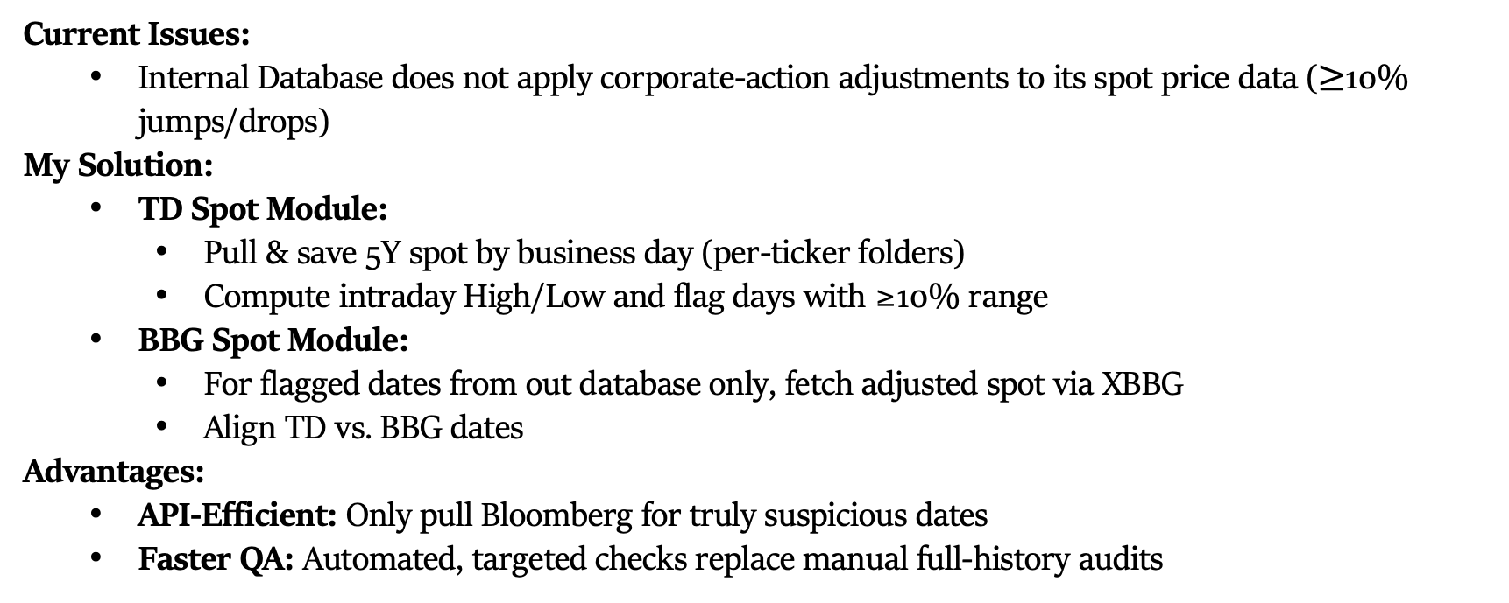
TD–BBG Spot Quality Assurance
Current Issues:
Internal Database does not apply corporate-action adjustments to its spot price data ($≥$10% jumps/drops)
My Solution:
TD Spot Module:
Pull & save 5Y spot by business day (per-ticker folders)
Compute intraday High/Low and flag days with ≥10% range
BBG Spot Module:
For flagged dates from out database only, fetch adjusted spot via XBBG
Align TD vs. BBG dates
Advantages:
API-Efficient: Only pull Bloomberg for truly suspicious dates
Faster QA: Automated, targeted checks replace manual full-history audits

Slide 15
Thank You
New GED Manager:

